Slide 1

Negative Feedback in Biochemical Networks
Herbert M Sauro
University of Washington
Bioengineering
In collaboration with Steve Wiley, Song Feng (PNNL) Michael Kochen and Steve Andrews (UW)

Slide 2
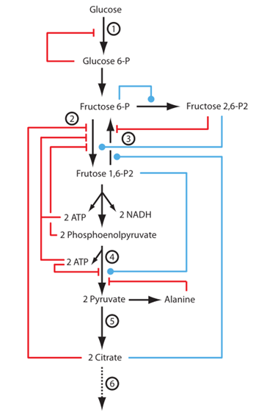
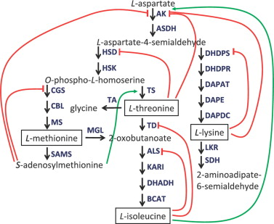
Negative Feedback
Amino Acid Biosynthesis:
Glycolysis:

Slide 3
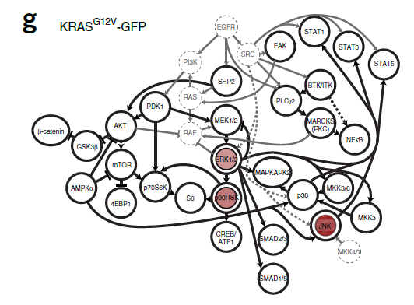
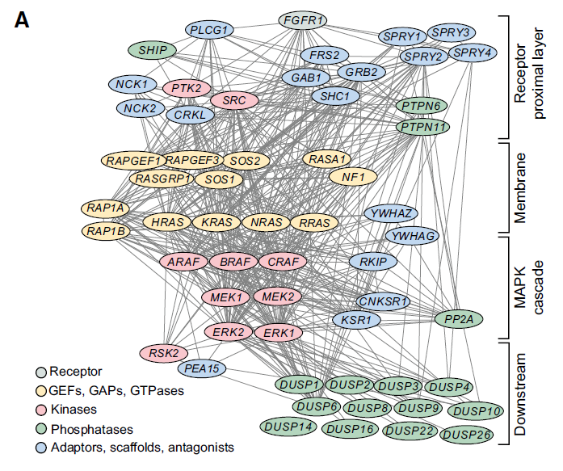
Signaling Networks
Influence of node abundance on signaling network state and dynamics analyzed by mass cytometry, Xiao-Kang Lun, Vito R T Zanotelli, James D Wade, Denis Schapiro, Marco Tognetti Nadine Dobberstein1 & Bernd Bodenmiller Nature Biotech, 2017
Optogenetic actuator – ERK biosensor circuits identify MAPK network nodes that shape ERK dynamics. Coralie Dessauges , Jan Mikelson, Maciej Dobrzyński, Marc-Antoine Jacques, Agne Frismantiene , Paolo Armando Gagliardi , Mustafa Khammash2 & Olivier Pertz. Mol Sys Biol, 2022

Slide 4
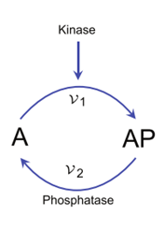
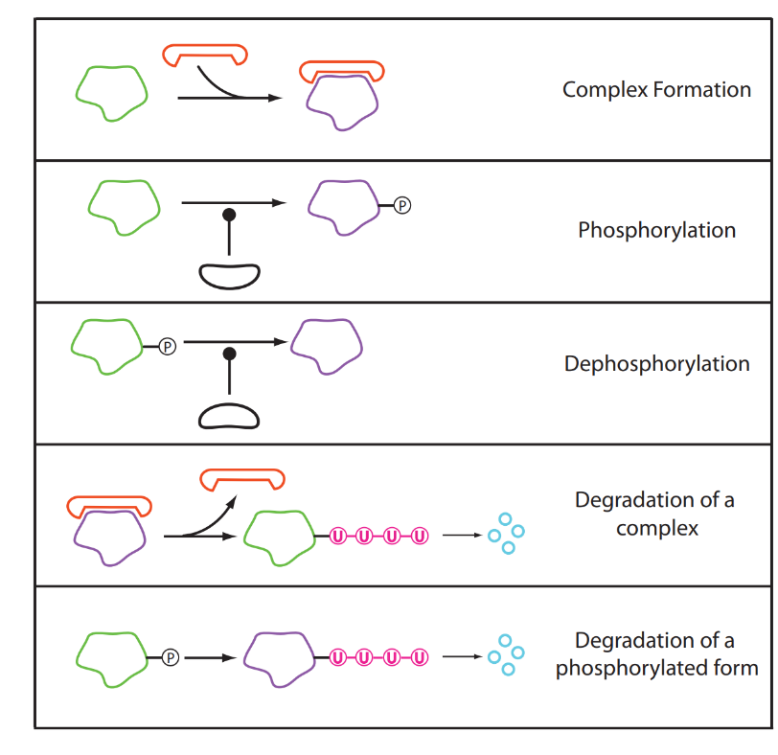
A fundamental processing unit
Phosphorylation cycles are a common and possibly
a fundamental unit in signaling pathways. They
can display a variety of behaviors.
There are only about 500 to 1000
kinases in a mammalian cell.

Slide 5
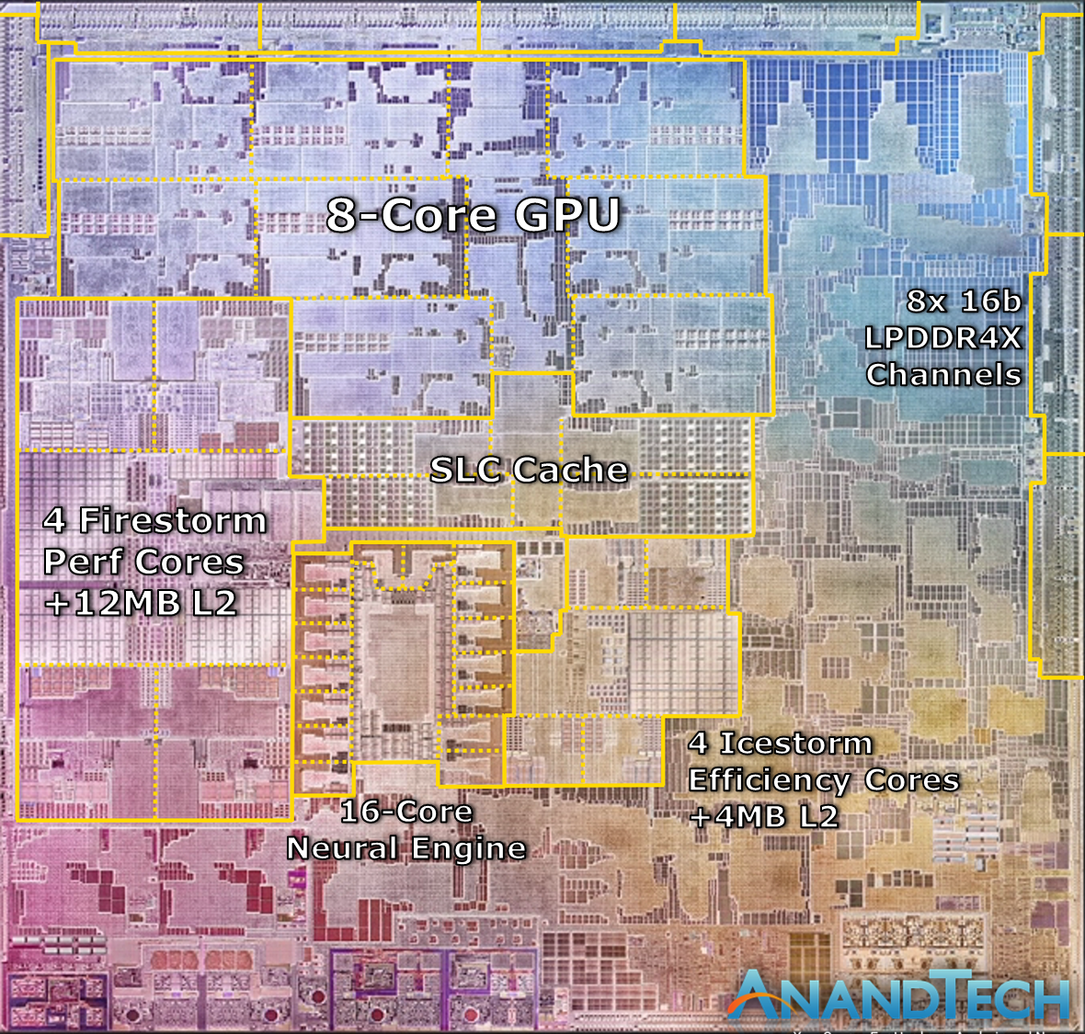
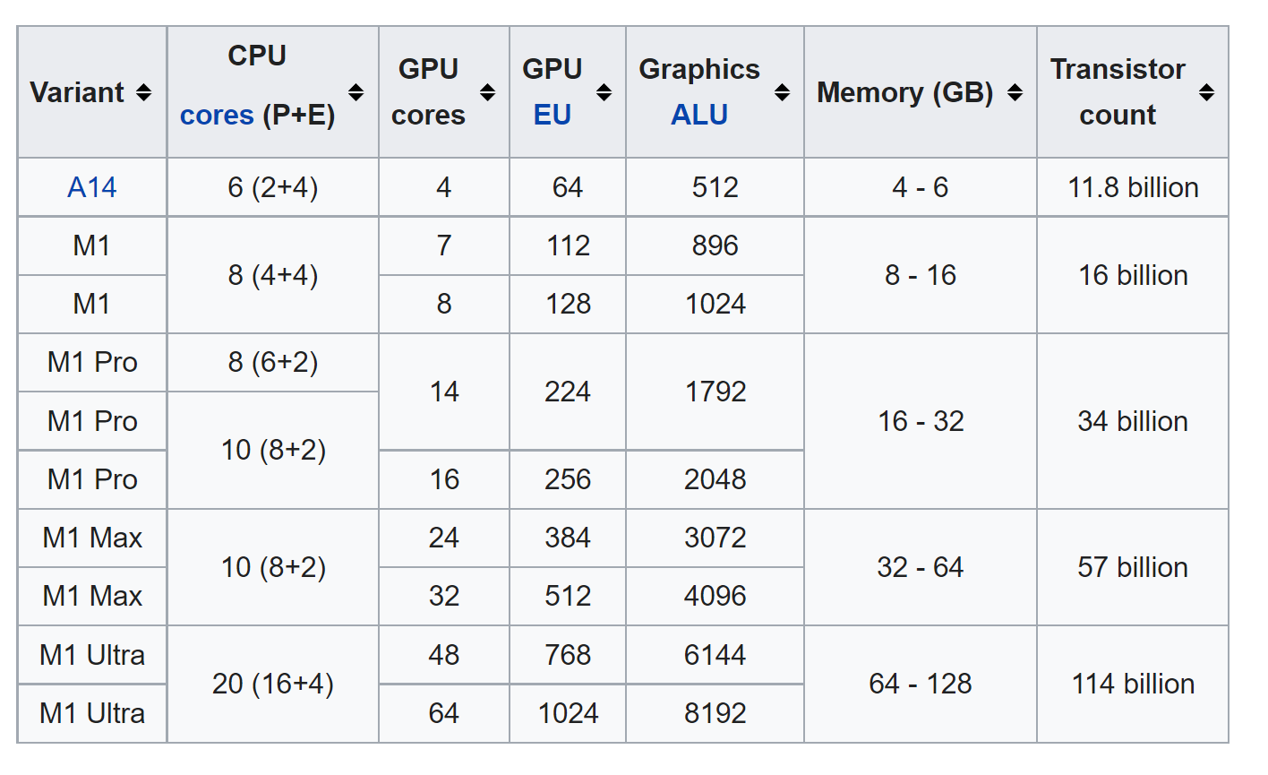
Humans are used to dealing with complexity

Slide 6
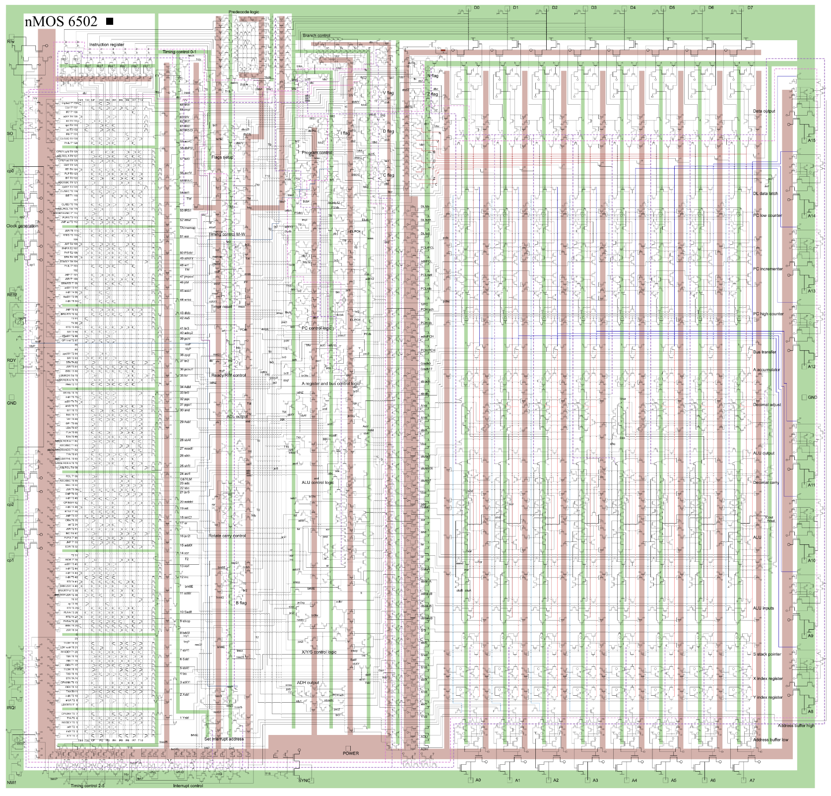
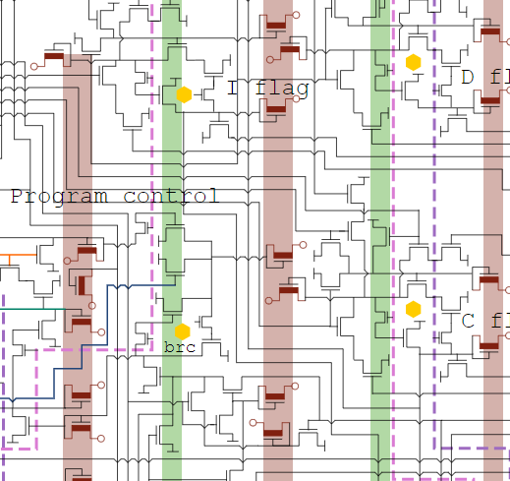
6502 Microprocessor at the transistor level

Slide 7
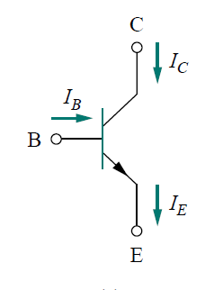
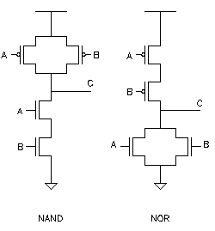
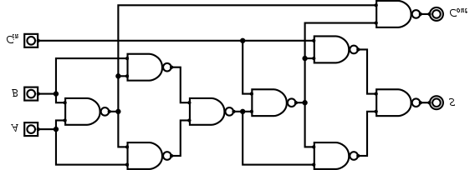
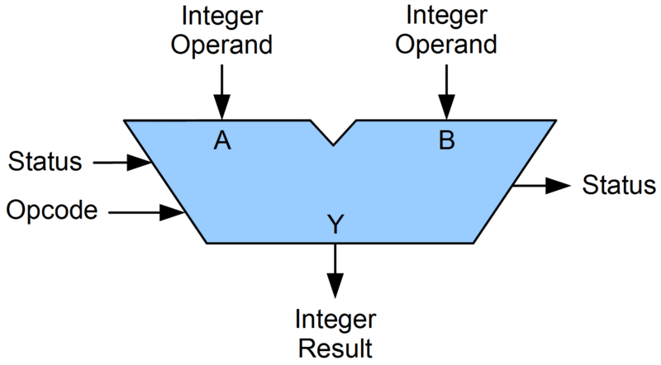
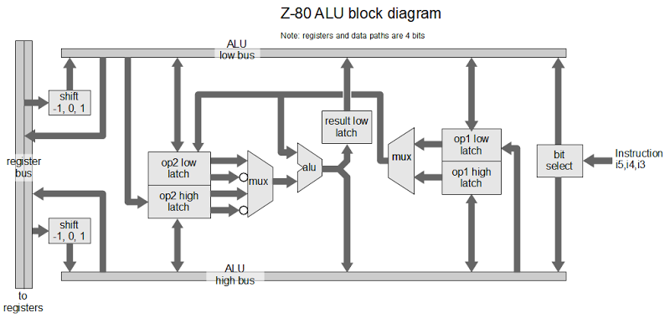
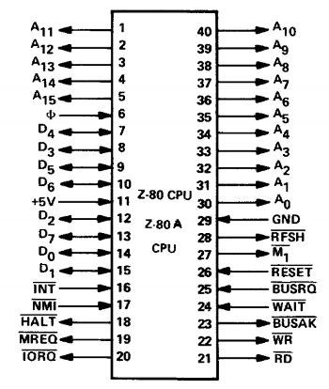
How do humans deal with complexity?
They use abstraction

Slide 8
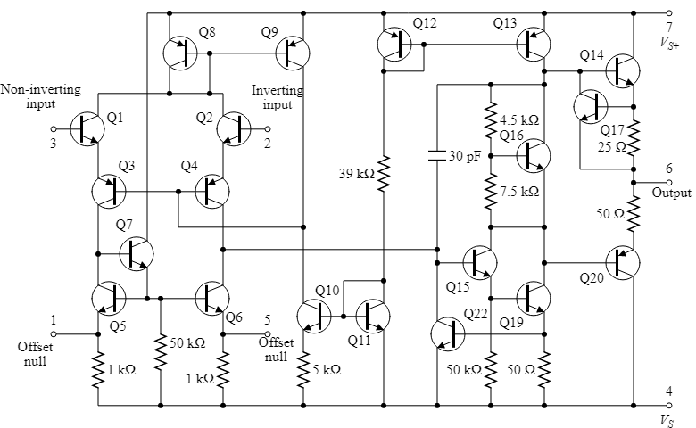
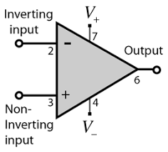
Reverse Engineer Analog Systems
VOUT = AO(V+ – V-)

Slide 9
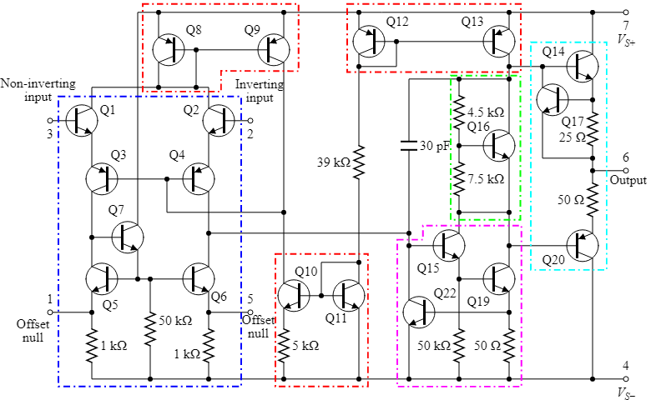
Operational amplifier
Current mirrors are outlined in red,
Differential amplifier in blue
Voltage level shifter in green
Output stage in cyan
Amplifier in pink
VOUT = AO(V+ – V-)

Slide 10
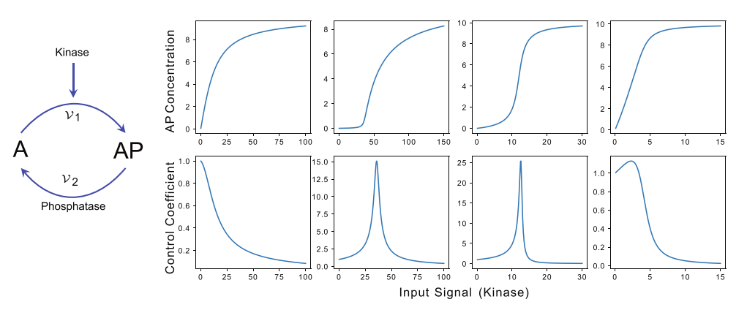
A fundamental processing unit
Phosphorylation cycles are a common and possibly
fundamental unit in signaling pathways. They
can display a variety of behaviors:
Hyperbolic
KmK > A,AP
Threshold
KmK > A KmP < AP
Sigmoidal
KmK < A,AP
Linear
KmK < A
KmP > AP

Slide 11
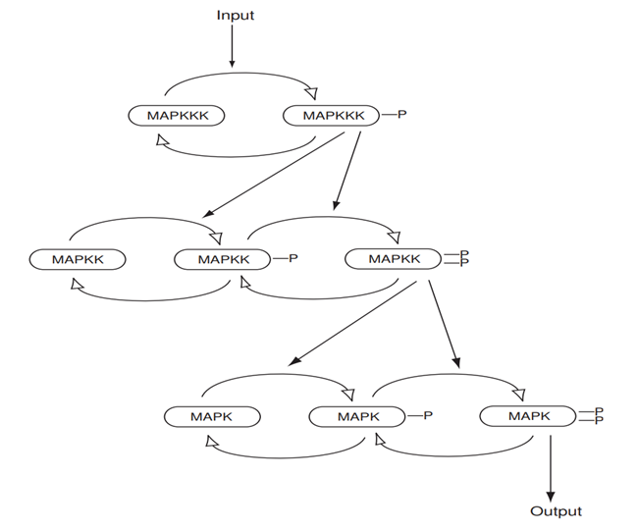
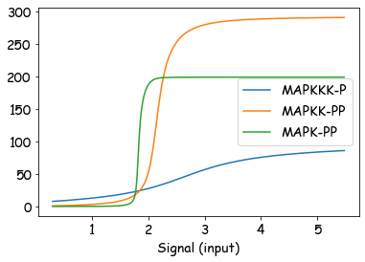
Ultrasensitivity in phosphorylation cycles

Slide 12
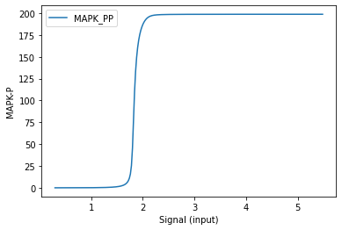
Ultrasensitivity in phosphorylation cycles

Slide 13
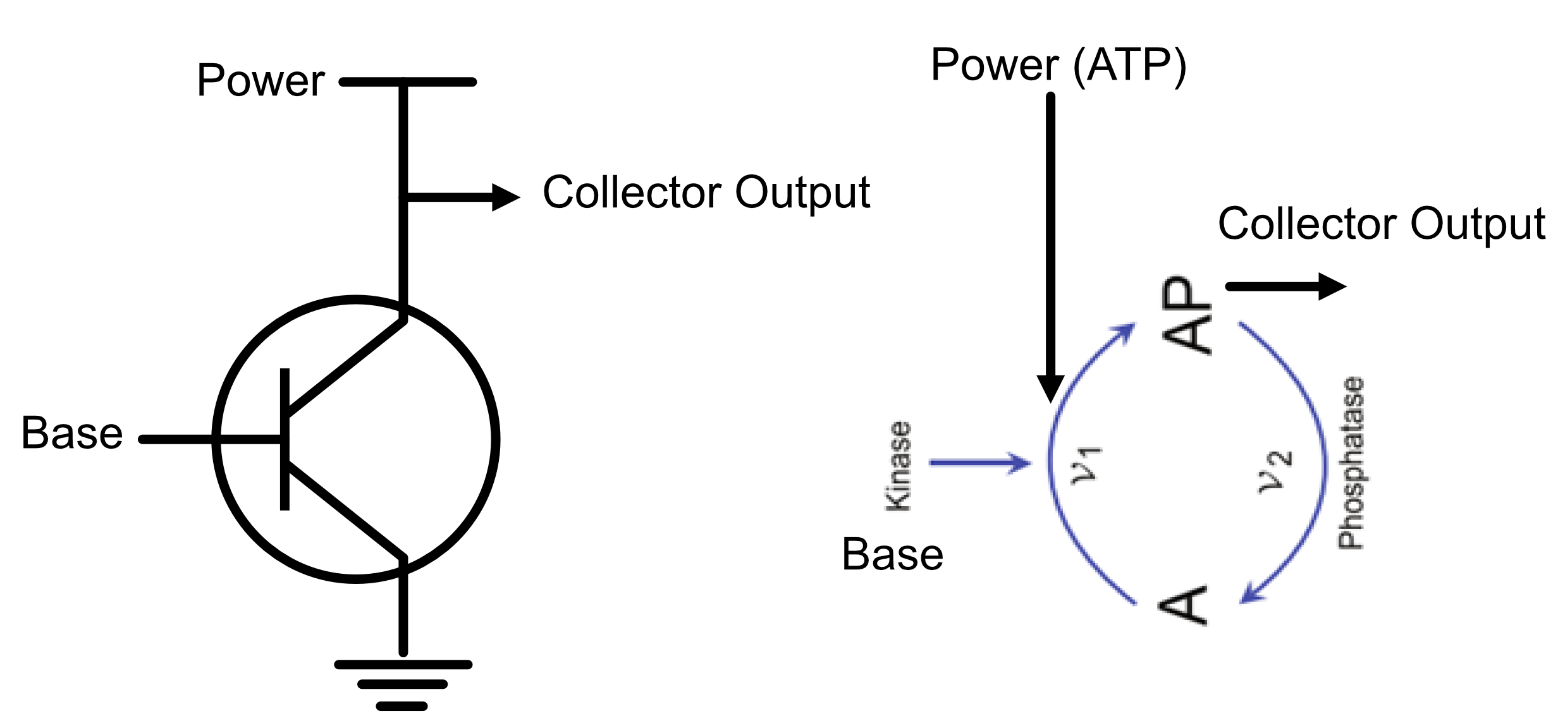
A fundamental processing unit
Response is very similar to a transistor or Op Amp

Slide 14
Modeling Approaches
There are different modeling approaches
Boolean networks
Unrealistic, too course grained
ODE based Michaelis-Menten level models
No account of sequestration effects*
* Kochen, Andrews, Wiley, Feng and Sauro. 2022, Dynamics and Sensitivity of Signaling Pathways. Current Pathobiology Reports 10:11-22

Slide 15
Modeling Approaches
There are different modeling approaches
Mass-action models
Could be the sweet spot, but can be overly very detailed
Rule-based mass-action models
Attempts to be hyper accurate but the models are massive and arguably unintelligible.

Slide 16
Modeling Approaches
There are different modeling approaches
Personal option:
A combination of Michaelis-Menten level and mass-action models
But with a eye to coarse grain models
Electronic engineers coarse grain all the time: akin to lumped parameter models. The transistor is a good example, modeling occurs above the level of solid state physics.

Slide 17
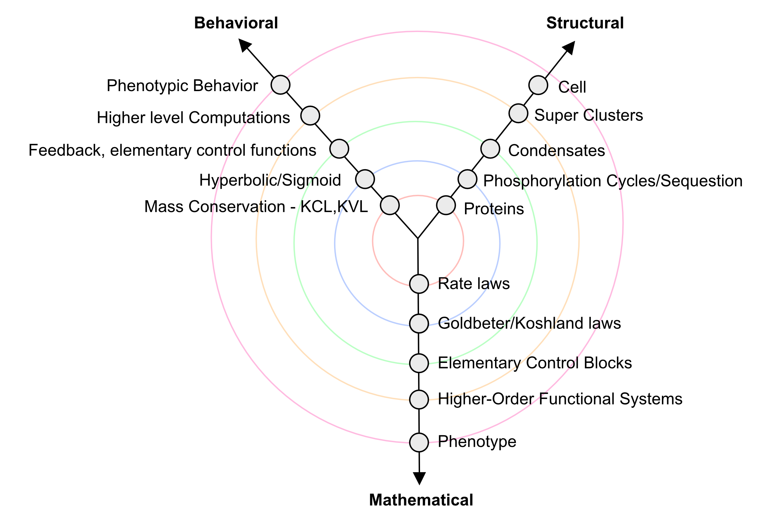
Coarse Graining Y-Chart of Signaling Networks

Slide 18
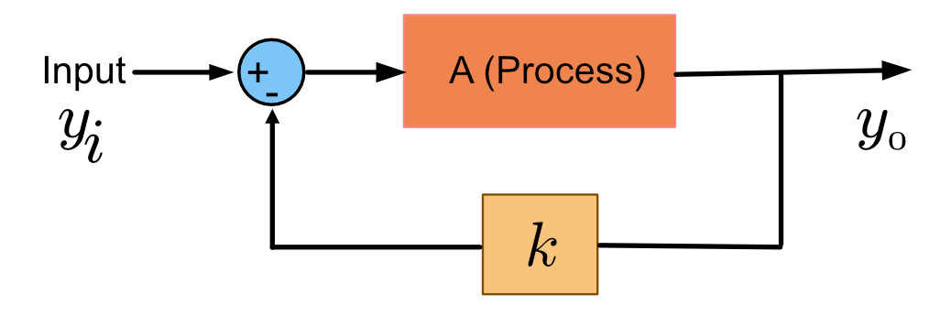
Simple Analysis of Feedback

Slide 19
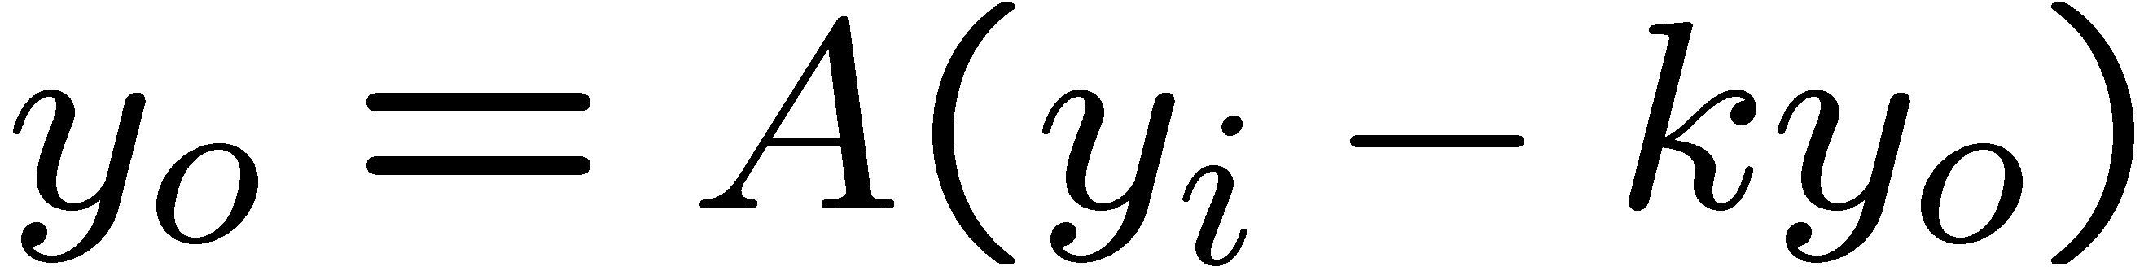
Simple Analysis of Feedback
Solve for yo:

Slide 20
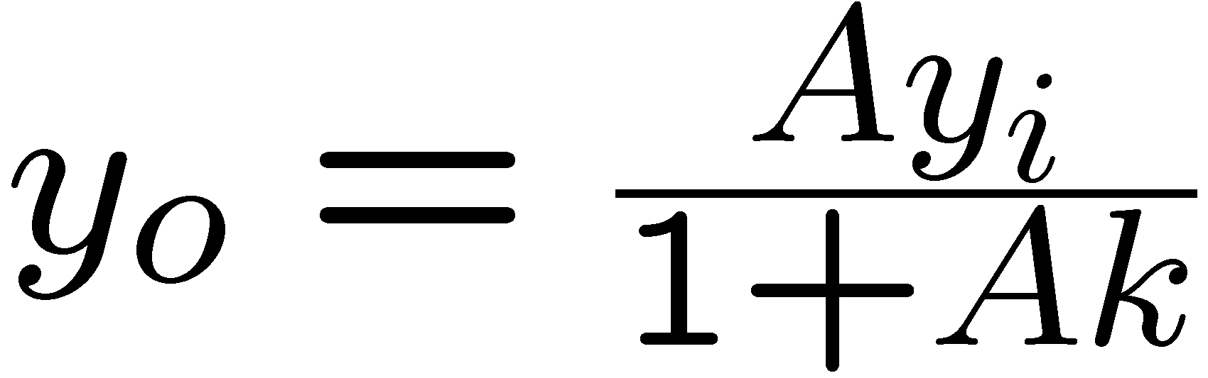
Simple Analysis of Feedback
All the nasty mechanistic
details abstracted away
inside here.
Solve for yo:

Slide 21
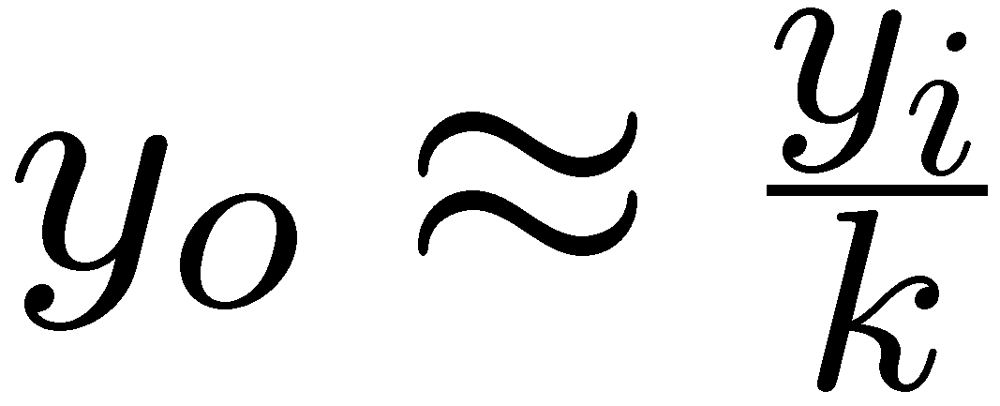
Simple Analysis of Feedback
At high amplifier gain (A k > 1):
In other words, the output is completely independent of the amplifier (the nasty mechanistic details) and is linearly dependent on the feedback.

Slide 22
Simple Analysis of Feedback
Basic properties of a feedback amplifier:
Robust to variation in amplifier characteristics.
Linearization of the amplifier response.
The addition of negative feedback to a gene
circuit will reduce the level of noise (intrinsic
noise) that originates from the gene circuit itself.

Slide 23
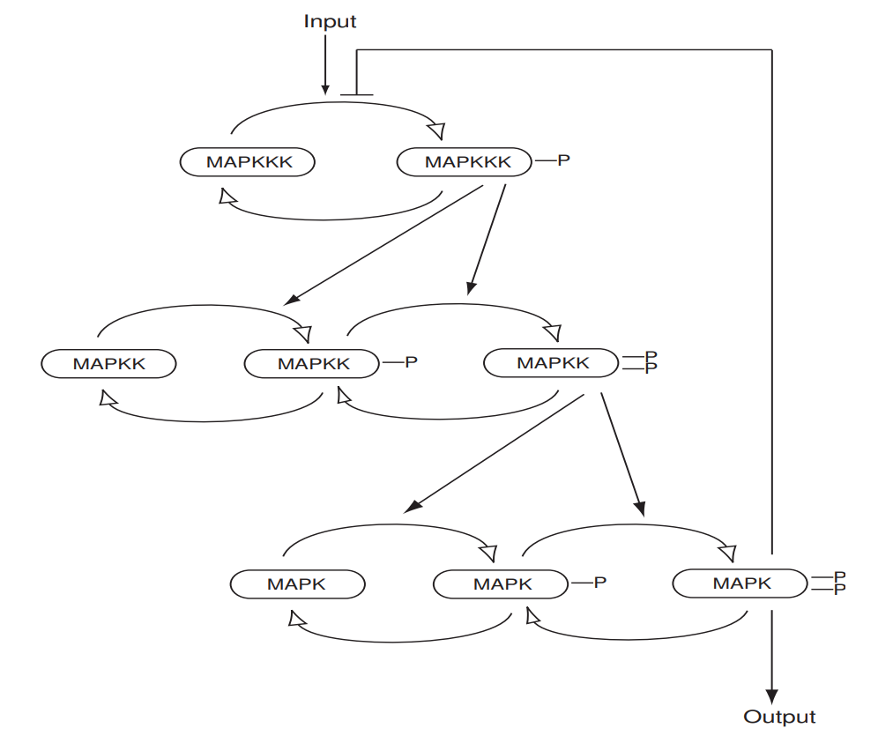
Let’s try adding a feedback to the model

Slide 24
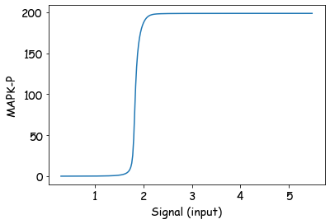
The Effect of Negative Feedback
No Feedback

Slide 25
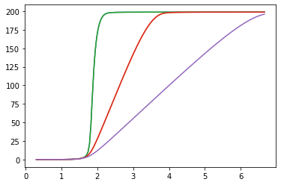
The Effect of Negative Feedback
With Feedback: Very robust in the sense that it doesn’t matter
if the details of the MAPK are not well characterized so long as
there is ultrasensitivity.
Its surprising that the overly
complex mechanistic model
can be reduced to a simple linear transducer.
Input, I
More Feedback

Slide 26
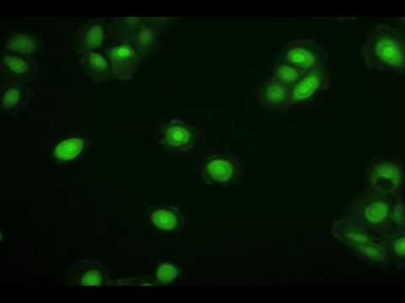
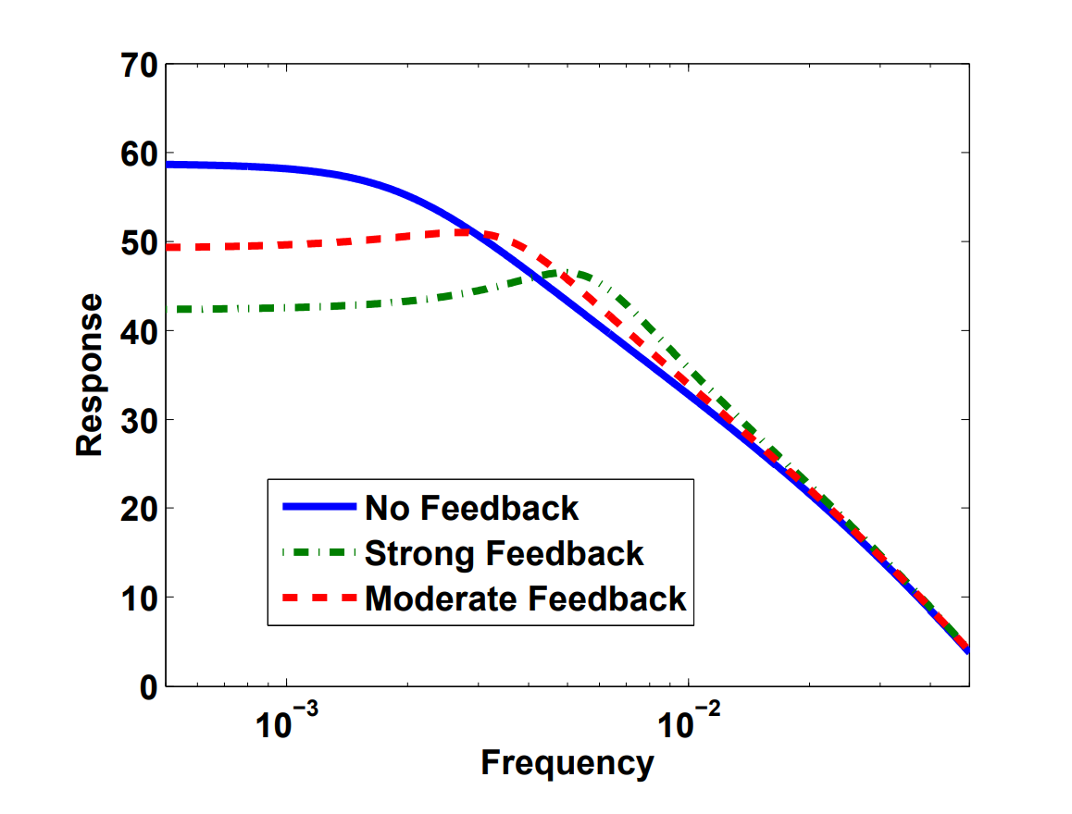
Amplifiers: Frequency Response
Bandwidth increases as feedback gets stronger
Small resonance peak emerging
Rapid and sustained nuclear–cytoplasmic ERK oscillations induced by epidermal growth factor Harish Shankaran Danielle L Ippolito William B Chrisler Haluk Resat, Nikki Bollinger Lee K Opresko H Steven Wiley Author Information Molecular Systems Biology (2009) 5:332 https://doi.org/10.1038/msb.2009.90
Knowing the mechanism of the feedback I don’t think it can get strong enough (but investigating at the moment) to generate oscillations, so instability must be coming from another source

Slide 27
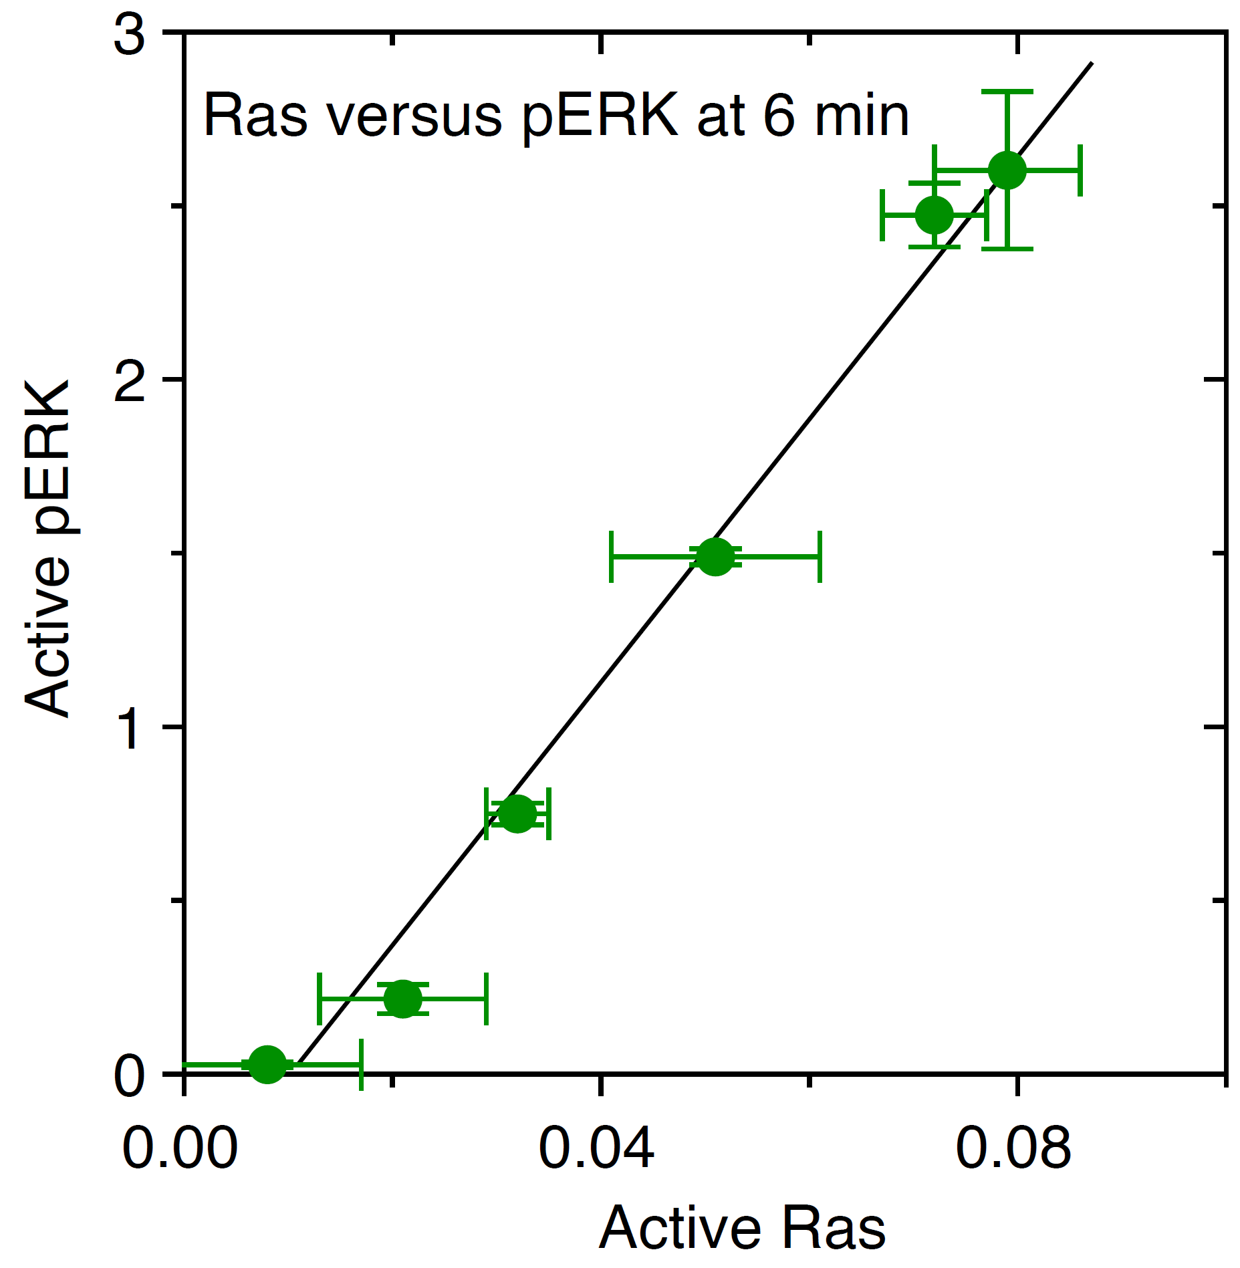
Unpublished data from Steven Wiley: MFC10A
EGF range 0.01 ng/ml to 30 ng/ml
Ras and pERK measured initially by ELIZA then
confirmed by proteome mass-spec.
Other predictions:
Over expression of RAF, MEK1, and ERK1 should result
in minimal changes to the response.
This also means drug targeting should avoid the
interior of the feedback loop.

Slide 28
Delving more into negative feedback systems

Slide 29
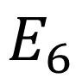
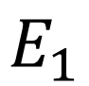
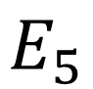
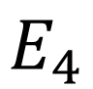
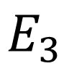
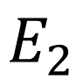
A linear chain with perturbation at e3
$$E_{1}$$
$$E_{2}$$
$$E_{3}$$
$$E_{4}$$
$$E_{5}$$
$$E_{6}$$
$$X_{o}→S_{1}→S_{2}→S_{3}→S_{4}→S_{5}→$$
Perturbation to this Enzyme

Slide 30
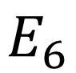
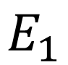
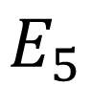
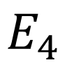
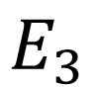
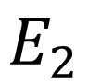
Conclusion: Irreversible Case
Perturbation to this Enzyme
$$E_{1}$$
$$E_{2}$$
$$E_{3}$$
$$E_{4}$$
$$E_{5}$$
$$E_{6}$$
$$X_{o}→S_{1}→S_{2}→S_{3}→S_{4}→S_{5}→$$

Slide 31
Conclusion: Reversible Case
Perturbation to this Enzyme
$$E_{1}$$
$$E_{2}$$
$$E_{3}$$
$$E_{4}$$
$$E_{5}$$
$$E_{6}$$
$$X_{o}→S_{1}→S_{2}→S_{3}→S_{4}→S_{5}→$$

Slide 32
What Determines the Effect of a Perturbation?
Can we estimate the effect of a perturbation without
having to do a simulation?
Yes, we can do small signal analysis, also known in the field
as metabolic control analysis.

Slide 33
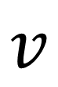
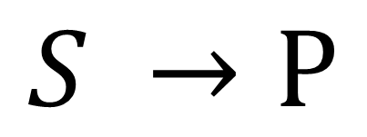
Consider a Single Reaction
$$v$$
$$S →P$$
How do S and P affect the reaction velocity, v?
It depends on the kinetic rate law.
The trouble is there are 100s of possible rate laws.
Instead we'll look at the sensitivity of v to changes in S or P

Slide 34
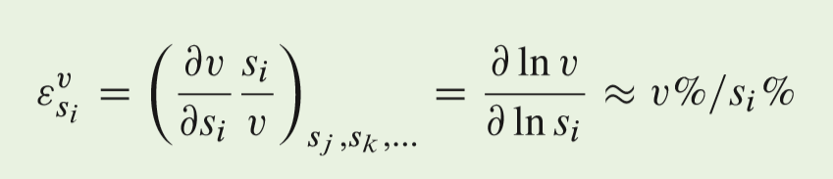






Consider a Single Reaction
$$v$$
$$S →P$$
Elasticity Coefficients
$$\frac{Δv}{Δs}$$
$$\frac{Δv}{Δp}$$
$$\frac{dv}{ds}$$
$$\frac{dv}{dp}$$
$$\frac{dv s}{ds v}$$
$$\frac{dv p}{dp v}$$

Slide 35


Elasticity Coefficients
$$v$$
$$S →P$$
Elasticity Coefficients are the unit measures that determine how
perturbations travel through a pathway.
Can be estimated using metabolite and Keq values

Slide 36

Elasticities – How Perturbations Jump from Step to Step

Slide 37

Elasticities Around a Two Step Pathway

Slide 38

Scaled and Unscaled System and Local Sensitivities

Slide 39


Writing the scaled sensitivities in terms of the elasticities
The key expression is in the numerator
which indicates the path the
perturbation takes

Slide 40




Chain of Causation in Terms of Elasticities
Describing the pictures mathematically in terms of elasticity Coefficients
It much simpler to look at how perturbations affect fluxes.
The percentage change in flux
if a 1% change is made in E1 is

Slide 41


Chain of Causation in Terms of Elasticities
Describing the pictures mathematically in terms of elasticity Coefficients
It much simpler to look at how perturbations affect fluxes.
The percentage change in flux
if a 1% change is made in E4 is

Slide 42


Chain of Causation in Terms of Elasticities
Describing the pictures mathematically in terms of elasticity Coefficients
It much simpler to look at how perturbations affect fluxes.
The percentage change in flux
if a 1% change is made in E3 is

Slide 43


The Impact of Perturbations at Different Points along the Pathway
Important result between the substate and product elasticities
This means it is easier to transmit changes downstream than up stream.

Slide 44










The Impact of Perturbations at Different Points along the Pathway
Increase Substate:
Increase Forward Rate by 10%
$$v_{f}=20$$
$$22$$
$$S$$
$$P$$
$$S$$
$$P$$
$v_{r}=$5
5
$v_{net}=1$5
$v_{net}=1$7
$$13\% Increase$$

Slide 45










The Impact of Perturbations at Different Points along the Pathway
Increase Substate:
Increase Forward Rate by 10%
$$v_{f}=20$$
$$20$$
$$S$$
$$P$$
$$S$$
$$P$$
$v_{r}=$5
5.5
$v_{net}=1$5
$$v_{net}=14.5$$
$$3\% Decrase$$

Slide 46

Distribution of Impact at Different Steps
100,000 simulations using random kinetic constants. The effect of the perturbation
computed in each case.
The influence of a perturbation is highest near the beginning of the pathway.

Slide 47








Chain of Causation in Terms of Elasticities
What about systems with negative feedback?
E1
E2
E3

Slide 48


Chain of Causation in Terms of Elasticities
Slight detour: What about systems with negative feedback?

Slide 49

Chain of Causation in Terms of Elasticities
Slight detour: Two routes for perturbations to travel:
This means that the biggest impact on flux occurs when we perturb the last step.
The regulated step which is traditionally considered the rate limiting step is not important.

Slide 50


Effect of Negative Feedback
5000 simulations of a 4 step linear pathway. Randomizing
rate constants while keeping Keqs fixed.
Step 4
Frequency
Step 3
Step 1
Step 2
Control Coefficient

Slide 51

Effect of Negative Feedback
5000 simulations of a 4 step linear pathway. Randomizing
rate constants while keeping Keqs fixed.
Step 1
Step 4
Frequency
Control Coefficient

Slide 52





Perturbation Paths through a signaling network

Slide 53
Using biochemical reaction networks to compute integrals Slides from Steve Andrews

Slide 54


Cells as signal processors:
E. coli chemotaxis is
a biased random walk.
Cells as signal processors:
E. coli chemotaxis
Movie from Howard Berg lab.

Slide 55


Cells as signal processors:
Chemotaxis exhibits perfect adaptation
Unbound receptors promote tumbling
+
R
CheR
CH₃
ATP
ADP
Y
P
Tar
Z
P
Y
receptor CheA CheY
cause
tumble
A
P
H₃C
W
-
Y
P
B
P
B
CheB
E. coli chemotaxis exhibits perfect adaptation.
Returns exactly back to where it started
Sourjik and Berg, 2002.

Slide 56
Integral feedback control
wind
• Proportional feedback adapts partially
• Integral feedback adapts perfectly
input
–
pathway
output
∫ dt
difference
–
set-point
E. coli chemotaxis adapts perfectly with integral feedback control:
R
T⁽⁰⁾*
T⁽¹⁾*
T⁽²⁾*
T⁽³⁾*
T⁽⁴⁾*
ligand
Y
T⁽⁰⁾
T⁽¹⁾
T⁽²⁾
T⁽³⁾
T⁽⁴⁾
Z
Yp
increased
tumbling
Bp
B
feedback
See: Barkai and Leibler, Nature, 1997; Yi, Huang, Simon, and Doyle, PNAS, 2000.

Slide 57
Biological applications of integral feedback control
• E. coli chemotaxis
• Yeast regulation of cell volume
• Mammalian blood glucose
• Dairy cow blood plasma calcium
• Plant nitrate homeostasis
• Etc.
See: Muzzey, et al., van Oudenaarden, Cell, 2009; Saunders, Koeslag, and Wessels, J. Theor. Biol., 1998; El-Samad, Goff, and Khammash, J. Theor. Biol., 2002; Miller and Smith, Annals of Botany, 2008.

Slide 58



Integrator: flux-restriction network (open loop)
v₁
v₂
Rate equation:
X
E
Ø
k_{in} (1st order)
Stationary value:
P
k_{out} (0th order)
P is the integral:
Ø
We call P neutrally stable
because it can take on any
value at steady state
P is integrating the error between the current E
and the steady state level of E
• Increase X at t = 0
• Causes E to increase
• P integrates E

Slide 59
Integral feedback control: flux-restriction (closed loop)
v₁
v₂
X
E
Ø
Rate equation:
k_{in} (1st order)
Setpoint value:
P
k_{out} (0th order)
P is the integral:
Ø
• Increase X at t = 0
• Causes E to increase
• P integrates E
• Feedback decreases E back to setpoint.
How do we know it’s exact? Answer: The E₀ equation.

Slide 60
Network variants work equally well
II.
III.
IV.
v₁(X,P)
k₂
k₁
k₂
v₁
k₂
X
Y
E
Ø
X
E
Ø
X
E
Ø
k_{in}
k_{in}
v_{out}(P)
Ø
v_{in}(E)
P
Ø
P
P
k_{out}
k_{out}
Ø
Ø
V.
VI.
VII. Antithetic control
X
v₁
E
v₂
Ø
v₁
v₂
v₁
v₂
X
E
Ø
X
E
Ø
Ø
S
v_{out}(S)
Ø
k_{in}E
v_{in}(E)
k_{f}E
S
P
Ø
P₁
P₂
Ø
k_{r}
v_{f}(S)
k_{syn}
k_{r}
k_{bind}
P
Ø
dP1/dt = vo – k P1 P2
At ss: P1 = vo/(k P2)
v1 = k P1 P2
v1 = k P2 vo/(k P2) = vo
Therefore v1 is zero order in P2
All of these:
• Integrate in open loop
• Adapt perfectly in closed loop

Slide 61





Essential components: Zeroth order reactions are essential
Both cycle reactions are zeroth order
(with respect to substrates):
v₁
E
v₂
X
Ø
$$\dot{P}=k_{f}E−k_{r}$$
k_{f}E
Cycle is only stationary if
S
P
$$E=\frac{k_{r}}{k_{f}}$$
k_{r}
Otherwise, cycle goes to all S or all P
• Zeroth order reactions create a neutrally stable species
If the cycle is stationary, then P can be anything and it won’t change
• Mathematically, the steady-state rate equations are underdetermined:
$$\dot{P}=k_{f}E−k_{r}=0$$
3 equations, 3 unknowns
but P isn’t in the equations,
so can’t solve for it.
$$\dot{S}={−k}_{f}E+k_{r}=0$$
$$\dot{E}=v_{1}\left(X\right)−v_{2}E=0$$

Slide 62
Removing 0th order breaks integration
X
v₁
E
v₂
Ø
first order
k_{f}ES
open loop:
P ≠ ∫ E
S
P
k_{r}
closed loop:
E doesn’t adapt
• P is no longer neutrally stable
• equations aren’t underdetermined
• So, integration and integral feedback
control fail to work

Slide 63
Adding cycles partially rescues integration
Signal input:
E
k_{f}ES₁
k_{f}ES₂
k_{f}ES₃
k_{f}ES₄
S₁
S₂
S₃
S₄
P
k_{r}
k_{r}
k_{r}
k_{r}
Signal output
sine wave in E
pulse in E
step in E
Integral is correct for short times, but fails at long times
How does it work?
• The chain isolates P from depletion at S₁ for a while,
so P is neutrally stable over short times.

Slide 64




Acknowledgements
Sauro and Ingalls, 2007, MAPK Cascades as Feedback Amplifiers, arXiv:0710.5195
Sauro H.M, 2017. Control and regulation of pathways via negative feedback. Journal of the Rpyal Society Interface.
Sauro, H.M., 2020. A brief note on the properties of linear pathways. Biochemical Society Transactions, 48(4), pp.1379-1395.
Kochen, Andrews, Wiley, Feng and Sauro. 2022, Dynamics and Sensitivity of Signaling Pathways. Current Pathobiology Reports 10:11-22
Integral Control: Under review
MAPK cascade as a feedback amplifier, in preparation
Small signal analysis of networks (metabolic control analysis)

